Slide 1
Question Answering for Legal Domain
Avengers Team‏

Slide 2
Roadmap
Definition
Motivation
How is it different from search engine?
Joint answer ranking system

Slide 3
What is Question Answering?
Type of information retrieval. Given a collection of documents ,the system should be able to retrieve answers to questions posed in natural language.
-Wikipedia

Slide 4
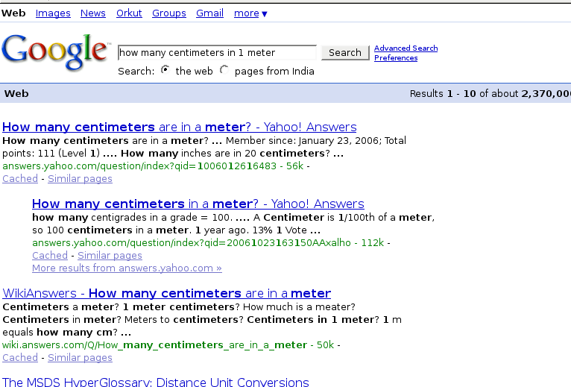
Motivation
Google Search

Slide 5
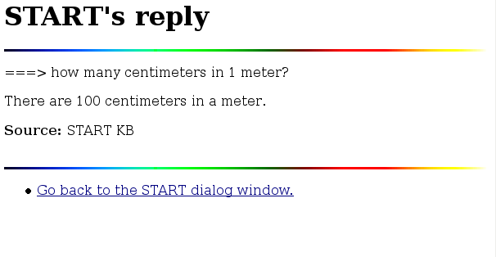
START search

Slide 6
Issues to be Considered
Question Classes
Question Processing
Data Sources
Answer Extraction
Answer Formulation
Advanced Reasoning for QA

Slide 7
Facts
Was developed by Boris Katz at MIT's Artificial Intelligence Laboratory
Was first connected to the World Wide Web in December, 1993
Key technique is "natural language annotation"

Slide 8
Two basic foundations
Sentence level Natural Language Processing capabilities
Natural Language Annotations

Slide 9
Natural Language Annotations
Computer analyzable collections of natural language sentences and phrases that describe the contents of various information segments
A pointer is associated with sentences which points to the information segment summarized by the annotations.
Instead of producing just the sentence as answer START follows the pointer and gives the text segment with the answer sentence.

Slide 10
A Joint Answer Ranking Model

Slide 11
Joint Answer Ranking
A graphical model based method.
Estimates the correctness of individual answers.
Gives corelation between the answers.

Slide 12
Candidate Generation
Document retrieval
Question analysis
Answer extraction

Slide 13
Issues with Candidates
Answer Relevence
Answer Similarity

